Slide 1
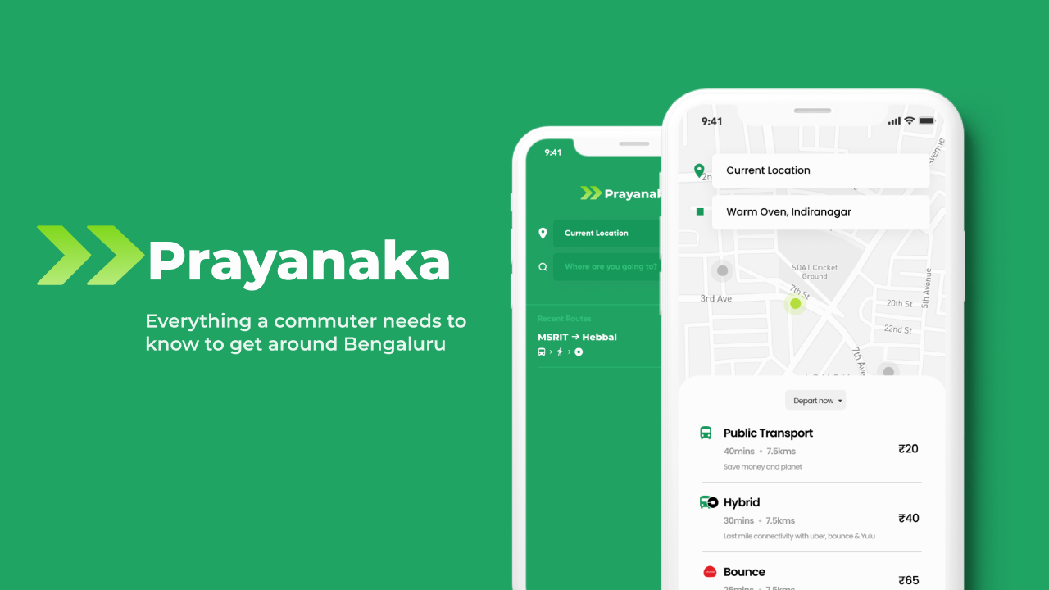
TEAM OUTLIERS
Ruthvika Mohan
Ranjan Pai Akanksha Bajaj

Slide 2
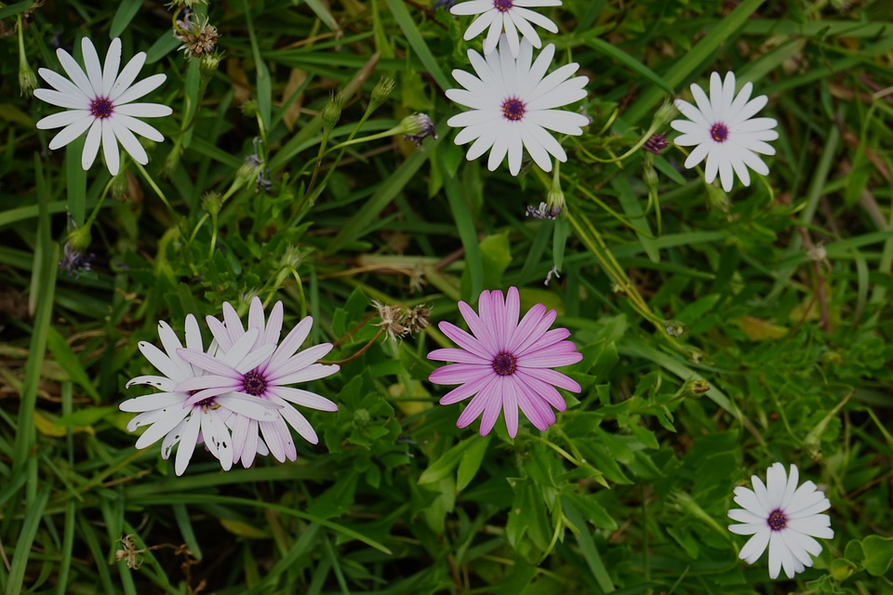
Team Outliers
Ruthvika Mohan
Data Analytics and Research
Connect on LinkedIn
Ranjan Pai
User Experience and Design
Connect on LinkedIn
Akanksha Bajaj
Urban Planning and Research
Connect on LinkedIn
Notes:
These images to be replaced with our prototypes.

Slide 3
Outline
The Problem
Solution Proposal
Commuter experience
Data Application + Case study 1
Connectivity Index + Case study 2
Cost-benefit analysis (how it benefits service providers)

Slide 4
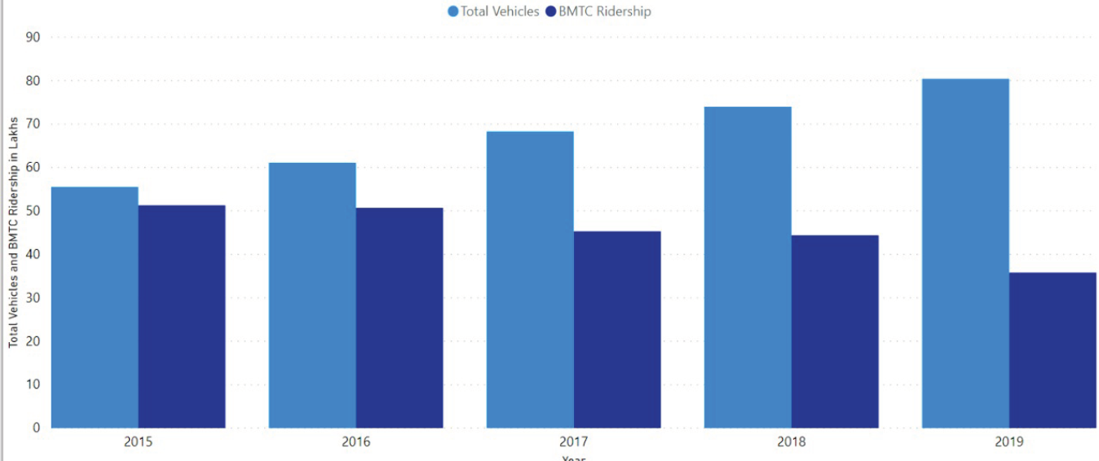
The Problem
Traffic Congestion in Bengaluru
Increasing population in the city has led to a growth in the number of private vehicles and reduction in the BMTC ridership.

Slide 5
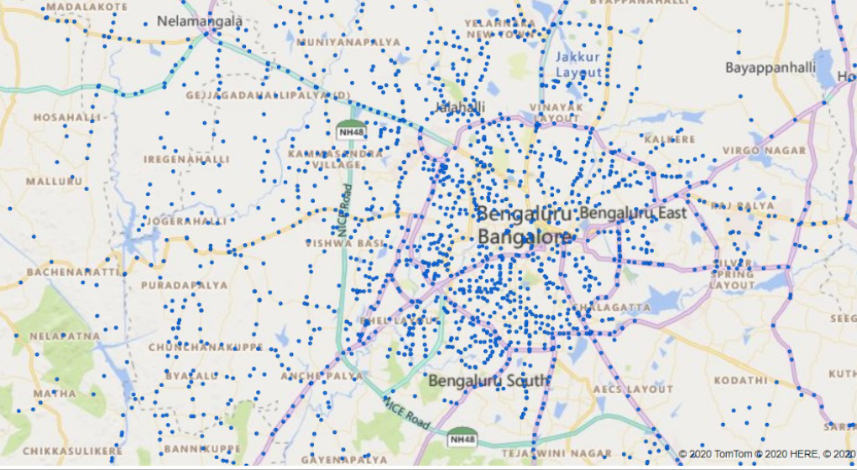
The Problem
Central Bengaluru shows a well-knit bus system but the exteriors lack connectivity, even though they are just as populous as the centre. This leads people to resort to personal vehicles or cabs and autos, thus increasing the footfall of vehicles.

Slide 6
Proposal
Creating a One Stop Solution for everything related to commute
Making Public Transport available to all areas using the connectivity index and user requests for service.
Providing last mile connectivity to Public Transport with options through a mobile application interface
Connectivity index facilitates service providers to locate their services and strengthen demand- supply relation

Slide 7
Options for commute
Journey Planning done considering:
Public transport arrangement Total cost of public transport ticket, crowdedness and waiting time
Ola, Uber availability, cost and ETA through APIs. Alert to book cab mid-journey so that waiting time for cab to arrive can be eliminated.
Parking arrangement at destination for travel in own vehicle.
Yulu, Bounce and VOGO stations if within 5 min walk radius

Slide 8
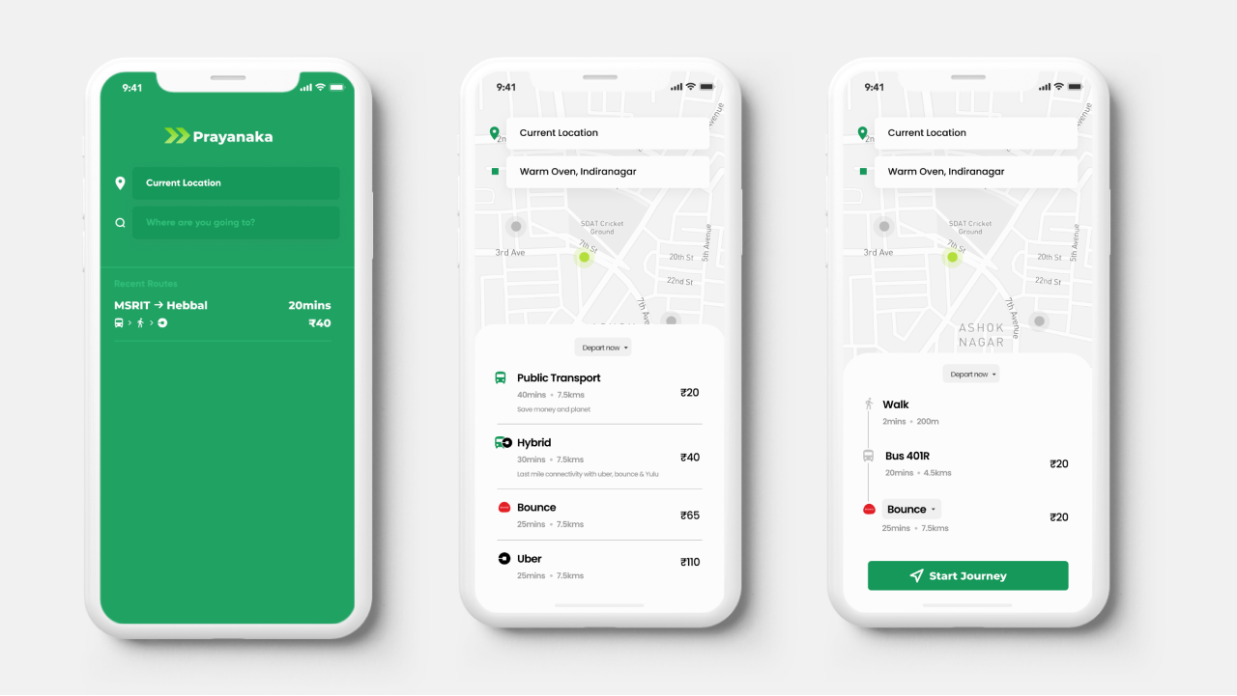

Slide 9
Data Collection and Application
Collaborating with existing data agencies
Give-and-take with private companies like Uber and Bounce
Introducing data collection methods when unable to source from existing data

Slide 10
Collaboration
01
BMTC
BMRCL
BBMP
Bangalore Traffic Police
Private Organizations such as Yulu and Uber
V
Building intelligence into existing methods to full potential and cutting costs on new installations.

Slide 11
Give and take
02
BMTC and BMRCL
GIVE
Data related to Waiting time
Bus routes, Stops, Schedules
Ticket Sales which is available through the Intelligent Transport System developed by BMTC and through already installed systems in the Metro Rail
TAKE
Promotion of Public transport as primary source of transport will increase the ridership. Identification of areas with less or no access can be equipped with mini vans to connect to nearest bus stop
WIN-WIN
Public transport usage will reduce traffic and pollution and increase the revenue for service providers Integrating real time data and the GPS from the bus drivers to eliminate factors of uncertainty and inaccessibility for commuters
The most important solution to Bengaluru’s traffic issue is increasing public transport ridership

Slide 12
Give and take
02
BBMP
GIVE
Data related to BBMP wards such as population, area, demographics, land use data to understand the mobility needs of the people better. Collaboration with Smart Parking System to automate process of parking spot identification, payment and vehicle security.
TAKE
A platform with various parameters quantified into scores for each ward to make more informed decisions. Deployment of smart parking system on Prayanaka for increased number of users as it is a one stop solution, therefore more users
WIN-WIN
Identifying areas of change for the betterment of the society and automation of processes through technology
A vital aspect of providing services is understanding the roads, demographics and land use.

Slide 13
Give and take
02
Bangalore Traffic Police
GIVE
Data related to traffic, video- processing, waiting time at signals to calculate accurate ETA and installation of additional data collection methods if necessary
TAKE
Better Traffic monitoring and placement, timing of signals
WIN-WIN
The primary solution to Bengaluru’s traffic issue is traffic management. With this collaboration, smoother commute is assured for citizens
Currently Google maps being used to monitor congestion levels and a difference of 20-30% is seen between actual time of travel and the one calculated

Slide 14
Give and take
02
Yulu/Bounce
GIVE
APIs to access Nearest Zone, Walking distance, Availability, Sanitation, Nearest drop off point to public transport
Data related to Number of zones, Available bikes, Trip details ( Source, Destination, Distance, Cost)
TAKE
Yulu as an option will increase ridership. More members added to Yulu/Bounce family as they are aware of zones near them . Usage of accessibility index to identify residential and interior areas to deploy services. Advanced service request platform to make informed choices
WIN-WIN
Integration of environmental friendly services for last- mile connectivity with public transport is the ideal choice for the commuter
Inclusion into the app so people know about Yulu/ Bounce as an option close to them while journey planning . A one stop solution so commuters can have one app for all needs

Slide 15
Give and take
02
Uber/Ola
GIVE
APIs to access ETA , Cost of trip, Sanitation details
Data related to Number of cars and autos, Trip details Source, Destination, Distance, Cost)
TAKE
Increased use of Uber Pool when it is provided as an option for commute, which means more riders and less cars for Uber. Feature to consider pickup point for pool as the nearest main road to increase efficiency. Service requests will help making informed decisions regarding expansion
WIN-WIN
Integration of environmental friendly services for last- mile connectivity with public transport is the ideal choice for the commuter
Uber is an integral part of journey planning in Bengaluru. We require your support to run all features smoothly. Included features : Uber Pool inclusion while taking nearest main road as pickup point | Deep Link to App to book ride or Same interface booking

Slide 16
New data collection methods
03
Microwave Radar- Congested routes without video-processing facility.
Multiple-lane vehicle detection available.
Inductive Loop- For smaller lanes which show high traffic levels. Vehicle and speed classification and occupancy measure available.
Investments made by BBMP or BTP
For real time updates additional methods of collection besides the Google maps API and private company data.

Slide 17
Connectivity Index
Calculated Accessibility scores , on a scale of 1-6, for few BBMP wards using available data
 |  | Public Transport |  | Yulu |  | Uber |  | Auto
 |  | Score | Grade | Score | Grade | Score | Grade | Score | Grade
ward 35 - Aramane Nagar (MSRIT) |  | 0.35 | F | 0 | F
ward 80 - hoysala nagar (INDIRANAGAR) |  | 5.4 | A | 4.8 | B
Ward 34 - Gangenahalli (MEKHRI CIRCLE) |  | 2.8 | D | 0 | F
ward 90 - Halasuru (ULSOOR LAKE) |  | 4.5 | B | 5.35 | A
ward 174 HSR Layout |  | 0 | F | 1.74 | E | 4.8 | B | 4.5 | B
ward 41 Peenya Industrial area |  | 2.5 | D | 0 | F
ward 187 Puttenahalli (JP NAGAR) |  | 0.3 | F | 0 | F | 4.3 | B | 4.1 | B

Slide 18
General Data Parameters made available to service providers
Road Density
Vehicle Density
Ratio of narrow roads to main roads
Number of Jobs in the area
Number of schools and colleges in the area
Ratio of average cost of travel (calculated using all options available in the area, average cost of a trip) to average daily wage
Number of road accidents in the area
Average speed of travel
Ratio of car parking spots to total cars
Ratio of two wheeler parking spots to total scooters
Average hourly cost of two wheeler parking
Average hourly cost of four wheeler parking
Number of residential, commercial tourist spots
Google reviews of BBMP Help centre

Slide 19
Public Transport Data Parameters used to calculate accessibility score
Number of bus stops,
Number of metro stations,
Ratio of Bus ridership with starting point and endpoint in that area to population
Metro ridership with starting point and end point in that area
Ratio of number of illuminated bus stops to total
Ratio of number of wheelchair accessible bus stop to total
Ratio of number of bus stops with shelter to total
Average frequency of a bus number at a bus stop
Number of requests on application
Average cost per kilometer to the commuter
Average profit/loss per kilometer to the service provider

Slide 20
Uber Transport Data Parameters used to calculate accessibility score
Ratio of shared trips to total trips
Ratio of shared trips starting from exact location to main roads
Ratio of cab ridership with starting point and end point in that area to population
Average number of cabs in the area in the morning rush hour
Average number of cabs in the area in the afternoon non-rush hour
Average number of cabs in the area in the evening rush hour
Ratio of cancellations to total trips in are
Ratio of Completed Uber trips starting in the are to trips ending in the area
Average cost per kilometer starting or ending the area

Slide 21
Yulu/Bounce Data Parameters used to calculate accessibility score
Number of stations
Average number of working bikes in stations
Average number of pickups in the area in the morning rush hour
Average number of pickups in the area in the afternoon non-rush hour
Average number of pickups in the area in the evening rush hour
Average cost per kilometre for trips starting or ending in that area
Ratio of daily bounce ridership to the population of ward

Slide 22
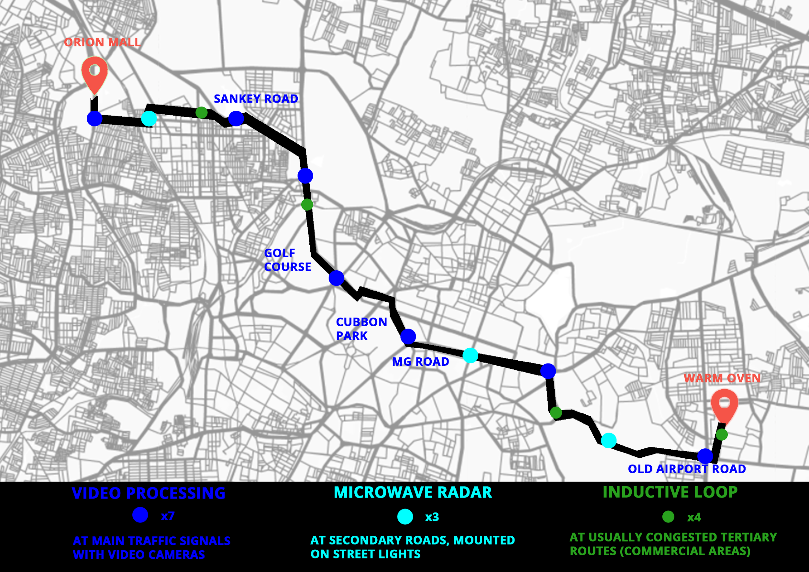
Case Study
WINDSORCIRCLE
Locating data collection methods based on availability of existing data, infrastructure and amount of congestion on roads.
TRINITY CIRCLE
Distance -14km
Origin- Orion Mall, Rajajinagar
Destination- Warm Oven, Indiranagar

Slide 23
The Technology
Data collected through existing methods or installations
Waiting time at signal calculated or time taken to travel between 2 points calculated using average speed
Google maps API used to find fastest route and Data collection methods used to find accurate ETA
Machine Learning algorithms used to find accurate traffic conditions at various times of the day, which will be done combining google maps and collected data
ETA in case study calculated using approximate values
Investments made by BBMP or BTP
Google Maps currently fails to consider waiting time at signals and this results in a 20-30% increase in time of travel when compared to ETA. This difference is not trivial in a metropolitan city like Bengaluru

Slide 24
ETA Calculation
 |  | Car |  |  | Bike
 |  | 10:00 AM | 2:00 PM | 6:00 PM | 10:00 AM | 2:00 PM | 6:00 PM
Google Maps |  | 35.0 | 35.0 | 36.0 | 28.0 | 28 | 31
 |  | 24.0 | 24.0 | 23.3
 | SIGNAL
1 | Orion | 3.0 | 1.0 | 5.0 | 3.0 | 1.00 | 5.00
2 |  | 3.0 | 3.0 | 3.5 | 3.0 | 3.00 | 3.48
3 |  | 2.5 | 2.5 | 3.0 | 2.1 | 2.14 | 2.73
4 | Sankey rd | 5.0 | 1.0 | 3.0 | 5.0 | 1.00 | 3.00
5 | Windsor circle | 5.0 | 3.0 | 5.0 | 5.0 | 3.00 | 5.00
6 |  | 1.9 | 1.9 | 2.0 | 1.7 | 1.76 | 1.88
7 | Golf course | 5.0 | 3.0 | 3.0 | 5.00 | 3.00 | 3.00
8 | MG road | 5.0 | 5.0 | 5.0 | 5.00 | 5.00 | 5.00
9 |  | 2.7 | 2.7 | 3.0 | 2.73 | 2.73 | 3.05
10 | Trinity Circle | 3.0 | 3.0 | 5.0 | 3.00 | 3.00 | 5.00
11 |  | 4.1 | 4.1 | 4.5 | 3.75 | 3.75 | 4.09
12 |  | 3.6 | 3.6 | 4.1 | 3.60 | 3.60 | 4.09
13 | Old airport road | 3.0 | 1.0 | 5.0 | 3.00 | 1.00 | 5.00
14 |  | 2.6 | 2.6 | 4.0 | 2.31 | 2.31 | 4.00
 |  | 49.4 | 37.4 | 55 | 48.24 | 36.29 | 54
Time spent at signal
1 min | Fast moving traffic
3 min | Medium speed
5 min | Slow paced

Slide 25
Case Study
Taking the example of JP nagar, making use of the connectivity index to benefit both commuters and the service providers.

Slide 26
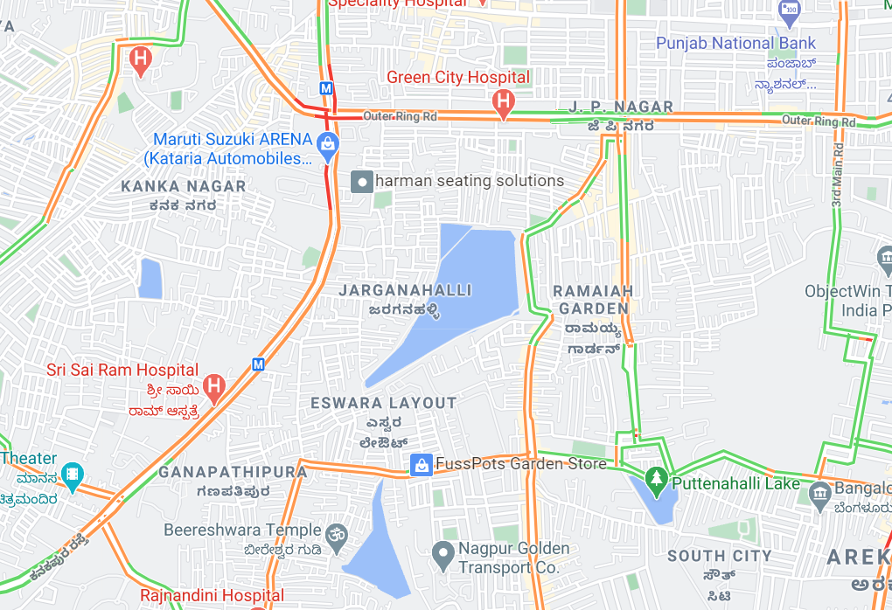
PROBLEM
Cabs, autos and personal vehicles are the primary reasons for traffic congestion.
JP Nagar does have a metro station but the population resorts to cabs because the metro stations are far from the residential lanes.
Typical traffic at JP Nagar on a working day around 6PM.

Slide 27
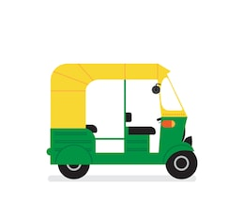
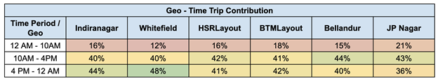
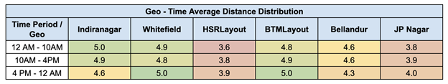
AUTOS
This percentage of all auto trips made in JP nagar are Uber autos.
Most of these rides are for short-medium distances around 4 km radius.
JP Nagar shows a large number of Uber auto ridership for short to medium distances.

Slide 28
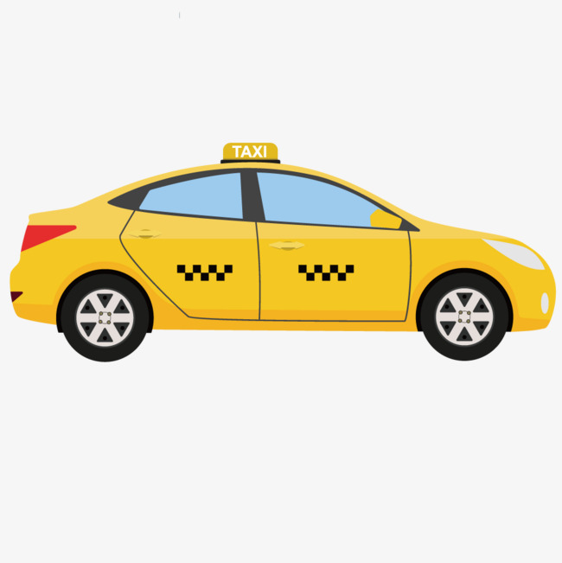
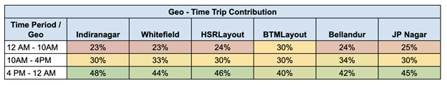
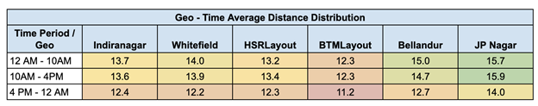
CABS
This percentage of all auto trips made in JP nagar are Uber cabs.
Most of these rides are for long distances around 15 km radius.
JP Nagar shows a large number of Uber cabs ridership for longer distances.

Slide 29
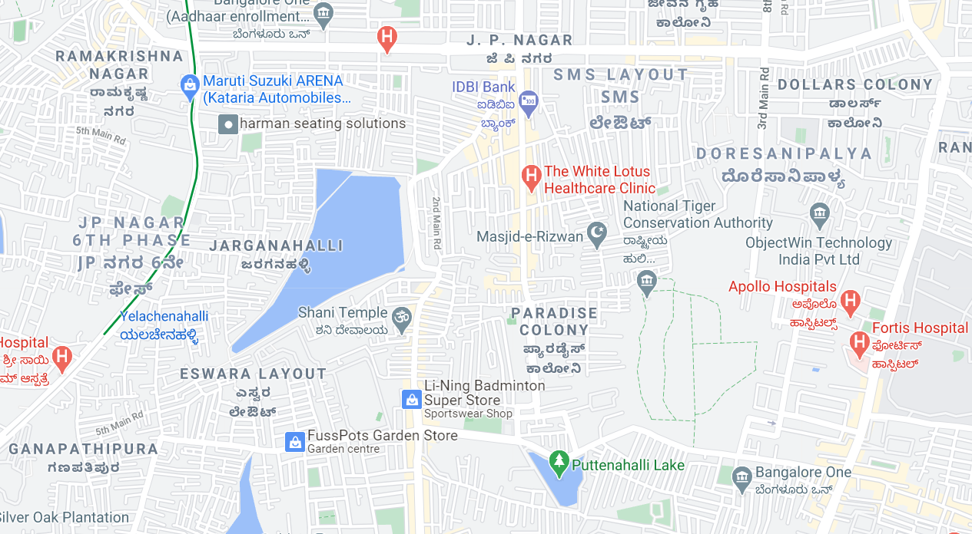
JP NAGAR METRO
SOLUTION
01
An introduction of Yulu stations- at the metro stations and a few scattered around the residential areas can encourage users to access the metro.
YELACHENAHALLI METRO
The stations are placed near civic amenities, parks etc. to not disturb the residences.

Slide 30
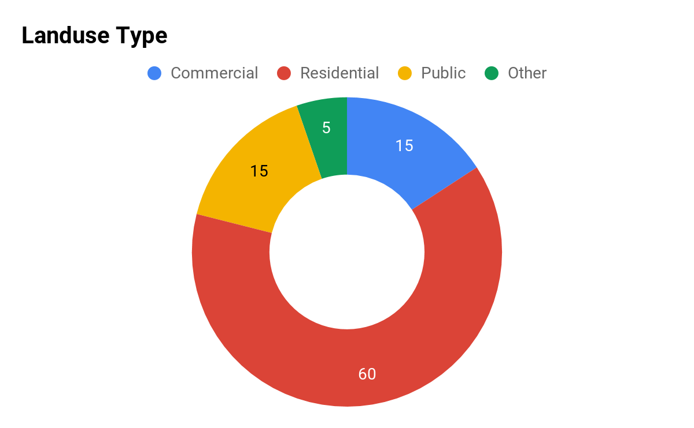
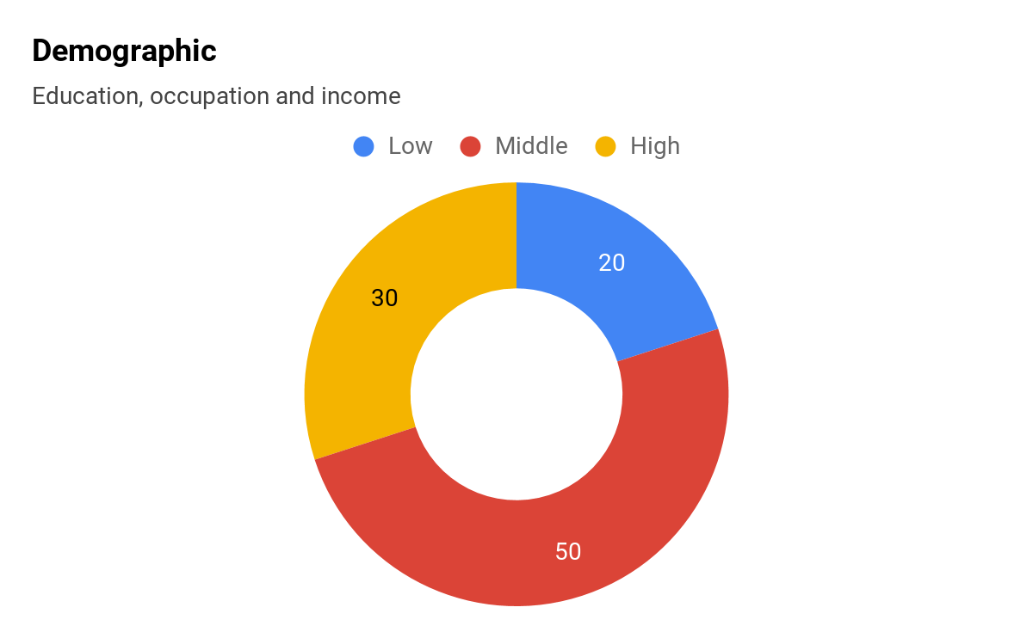
SOLUTION
02
Promoting carpools and walks by alerting users of their environmental impact.
JP Nagar is populated with residences and commercial spots. The demographic shows eco-conscious youth and adults. Prompting the users with their ecological impact can enable them to make choices like travelling by public transport, cycles, walks and carpooling.
For individual cab rides, "Would you like to ride alone? Sharing this ride with a coworker or carpooling will reduce your ecological impact by half."
For trips less than 1.5kms, "This walk will take you less than 8 minutes and save the planet a tree."

Slide 31
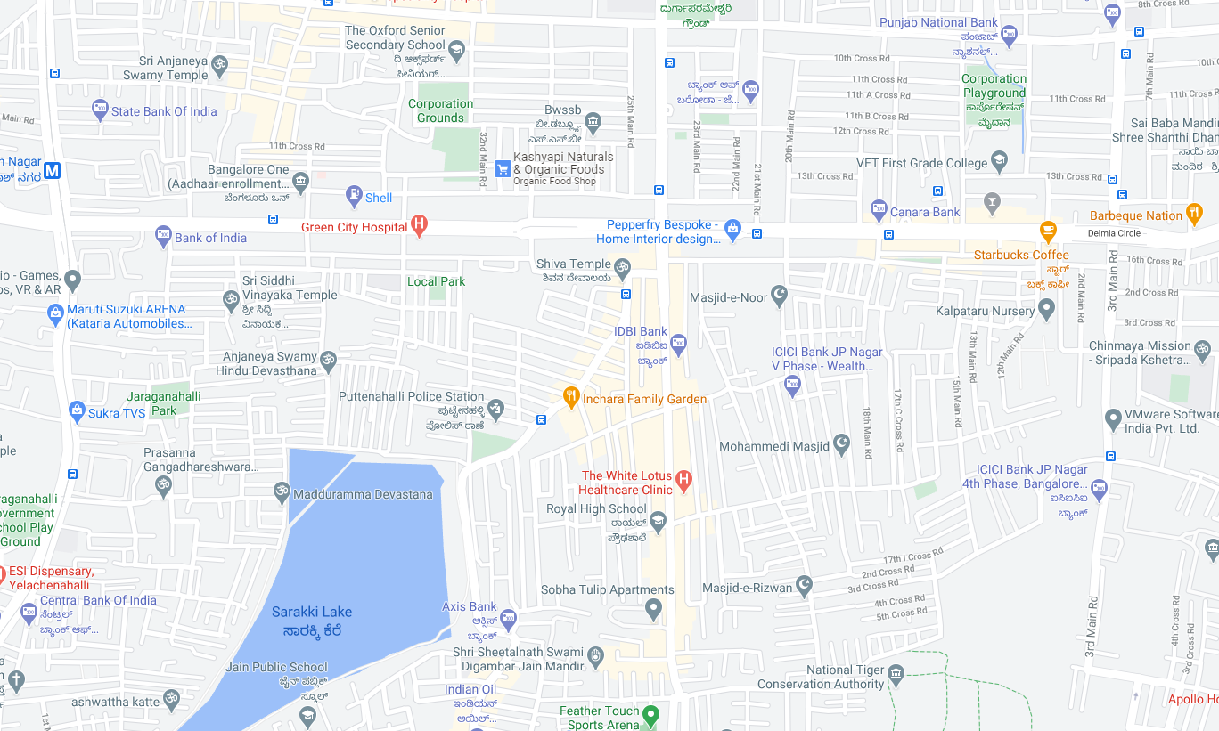
JP NAGAR 15th CROSS BUS STOP
SOLUTION
03
To increase the BMTC ridership, users can request for a connecting bus close to them.
Having smaller mini bus services circulating in the residential radii of 1-2 kms can facilitate users to easily get to the bus stop.
In JP Nagar the 15th cross Bus Stop is the most active and well-connected.

Slide 32
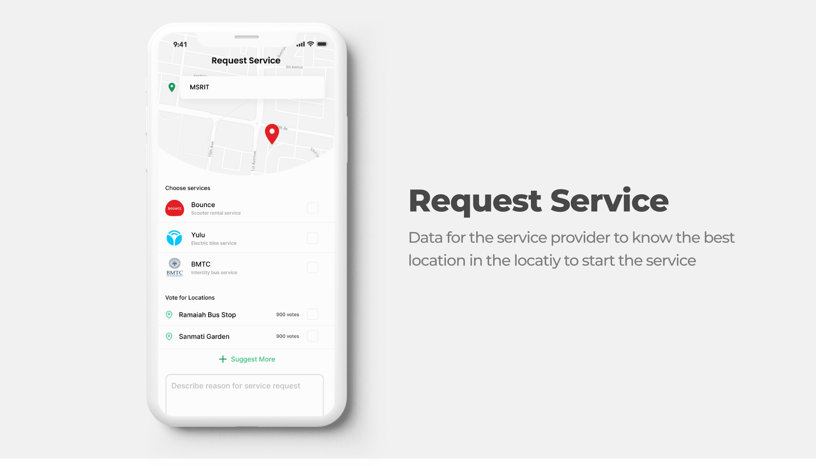

Slide 33
Conclusion
The team at Prayanaka aims at providing a one stop solution to all the problems a commuter at Bengaluru could face. With the collaborative efforts of all the organizations involved, we can truly make the ‘Garden City’ a better place. Bengaluru is a metropolitan city with a population of 1.2 crore and a literacy rate of 89%. Looking at the demographics of the city, we can involve at least 60-70% of the population in the usage of the app. The application offers maximum convenience. It is packed with state -of-the-art features and is user friendly. Once the primary goal of promoting public transport is achieved, ridership will increase and the number of cars on road will decrease drastically. We are looking at releasing the application in 3 phases. The first phase will involve data collection in terms of service provision requested through the application. The second phase will involve increase in number of buses and mini van services. The third phase will be aimed at making “Prayanaka” a household solution and hopefully the only application a Bangalorean will have installed on their mobile devices for commute needs. Looking forward to a better and smart future!

